Slide 1
Internet Censorship and Online Speech Chapter 6: Platform Censorship and Content Moderation
Nick Feamster University of Chicago

Slide 2
Platform Moderation: The Future of Censorship
Who gets to communicate? Filtering and manipulation of Internet protocols
HTTP, TCP/IP, DNS
Circumvention tools (e.g., Tor)
Who/what can be heard? Filtering and manipulation on Internet platforms
Automated filtering
Filter bubbles, Personalization (and attacks)
Propaganda and bots

Slide 3

Reducing “Unwanted Traffic” on the Internet… an “Old” Problem!

Slide 4

Filtering “Unwanted Traffic” (Spam)
Prevent unwanted traffic from reaching a user’s inbox by distinguishing spam from ham
Question: What features best differentiate spam from legitimate mail?
Content-based filtering: What is in the mail?
IP address of sender: Who is the sender?
Behavioral features: How the mail is sent?

Slide 5
Applying AI to Identify Spam…

Slide 6
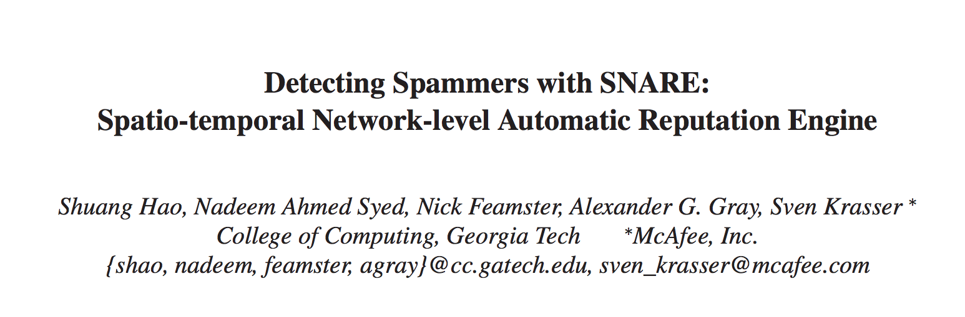
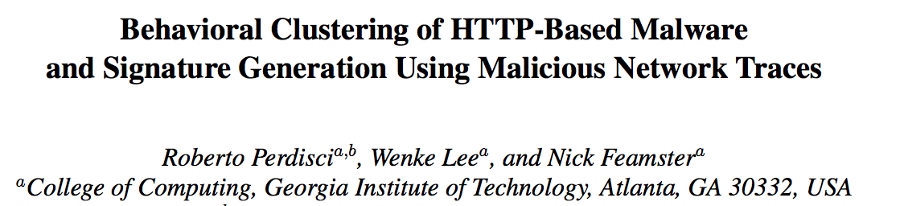
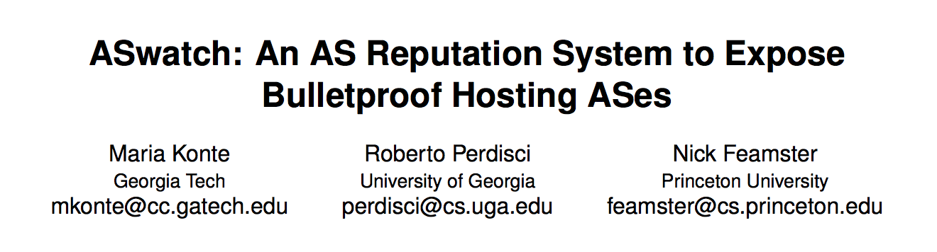
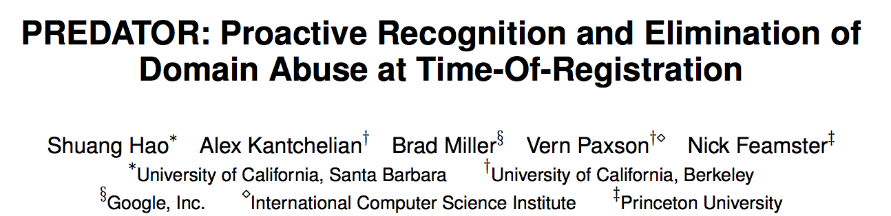
AI for Takedown of “Unwanted Content”
Email Spam (2009)
Web-based Malware (2010)
Bulletproof Web Hosting (2015)
Early Detection of DNS Abuse (2016)

Slide 7
Platforms Can Control Speech
Domain registration
Domain resolution
Content delivery
News platforms
Social media
…

Slide 8
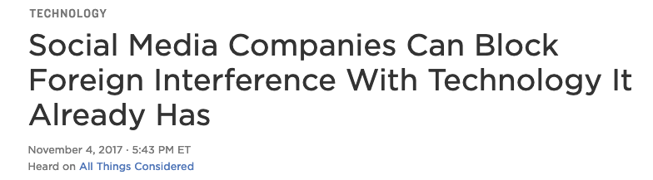


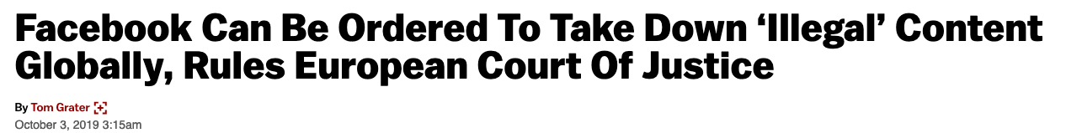
The Pressure to Automate is Growing
Calls for fast action
(Mis)understanding of the capabilities of automated algorithms.

Slide 9
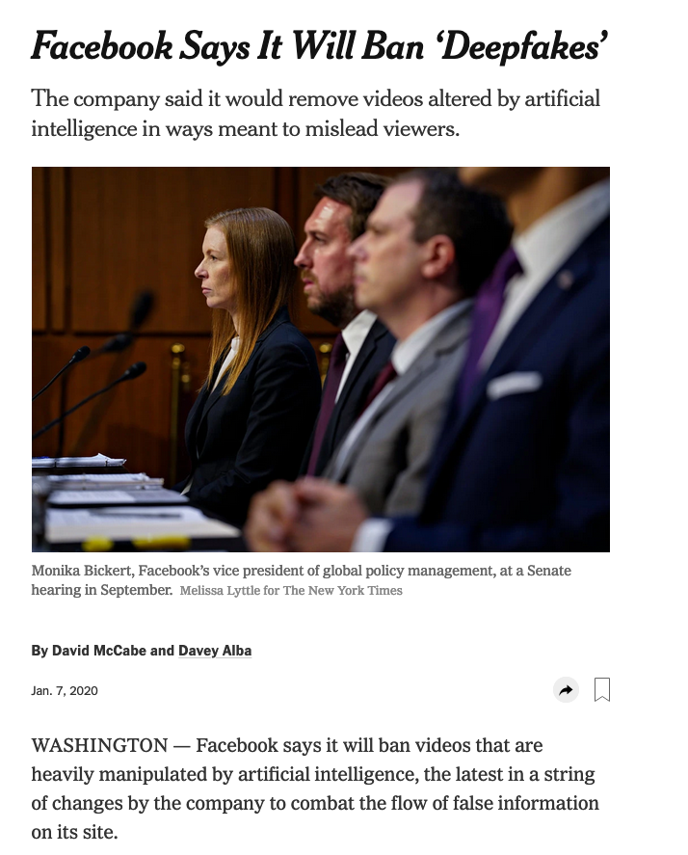
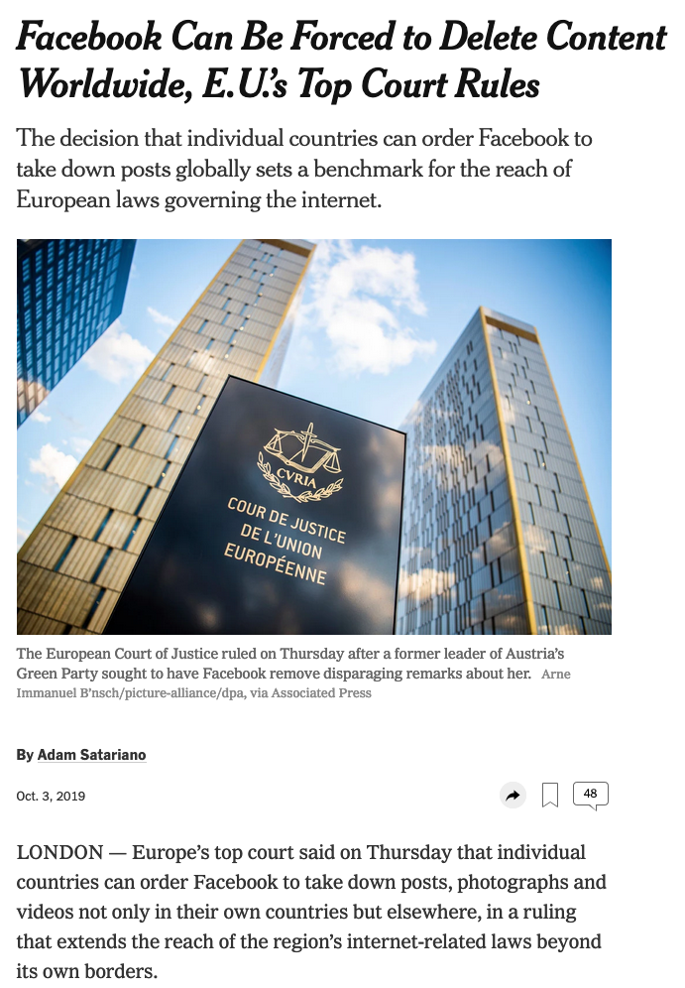

Slide 10
…once you get the AI to filter out the “bad stuff”, we’re good!

Slide 11

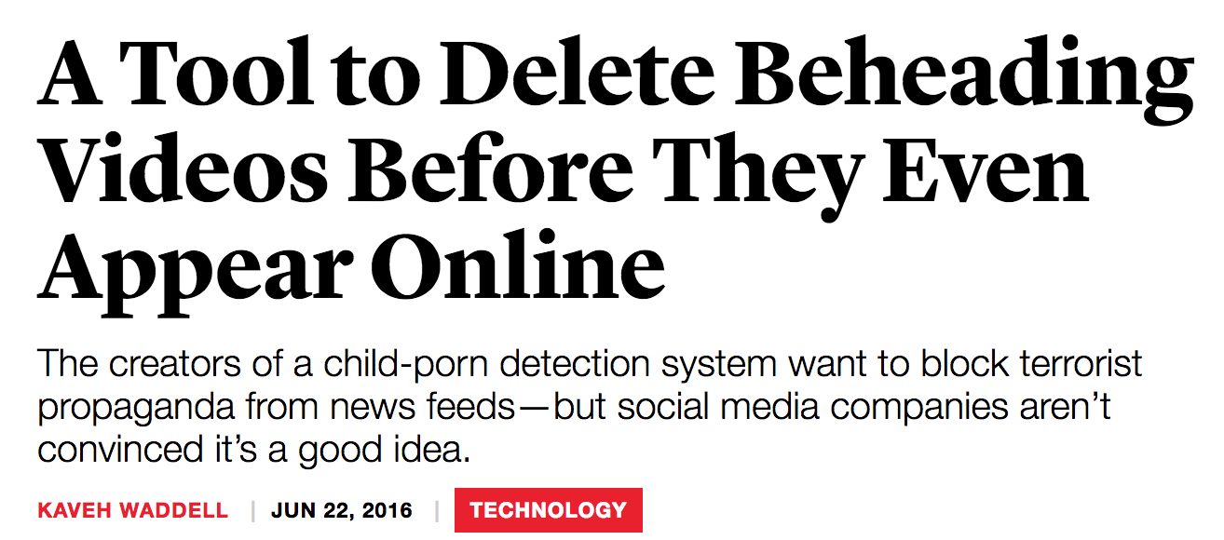
Automated Filtering and Speech
Notes:
“oh wait… you can take down other stuff, too?”

Slide 12
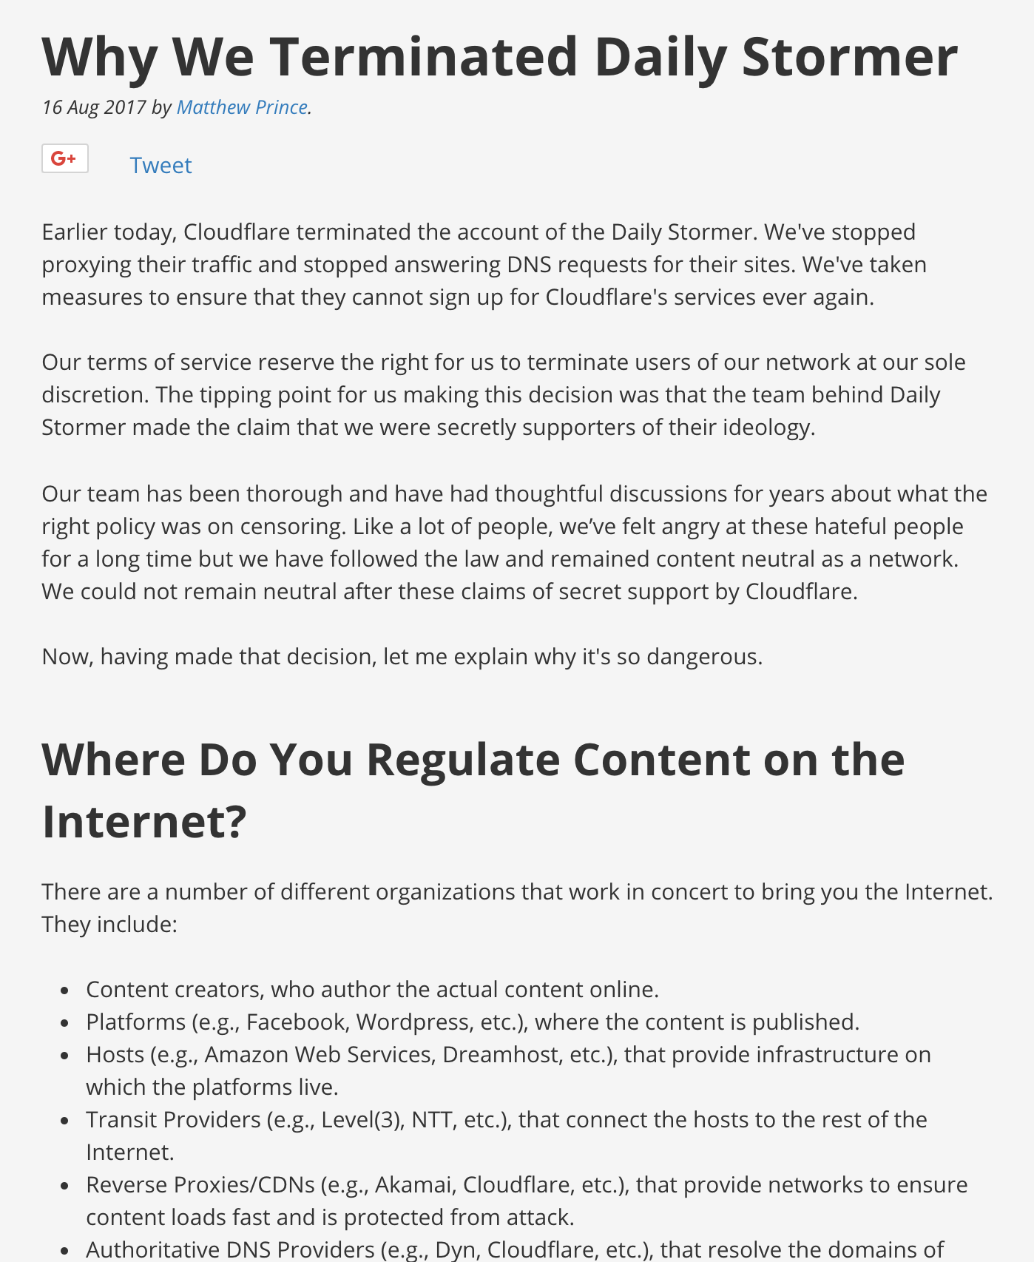

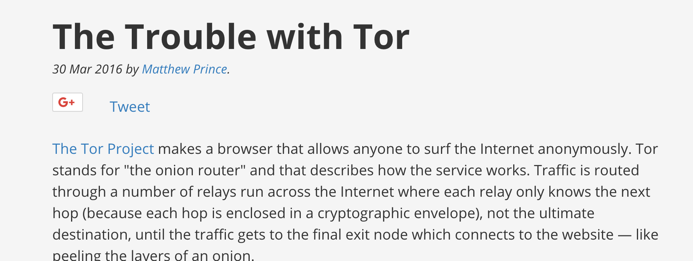
Centralization of Internet content platforms is exacerbating takedown risk.

Slide 13
What Technologies are Used to Identify ”Unwanted Content” Today?

Slide 14
Content Fingerprinting
Hash-based fingerprinting (e.g., PhotoDNA)
Spectral fingerprinting (e.g., Audible Magic)
“Perceptual hashing” (e.g., Insight)

Slide 15
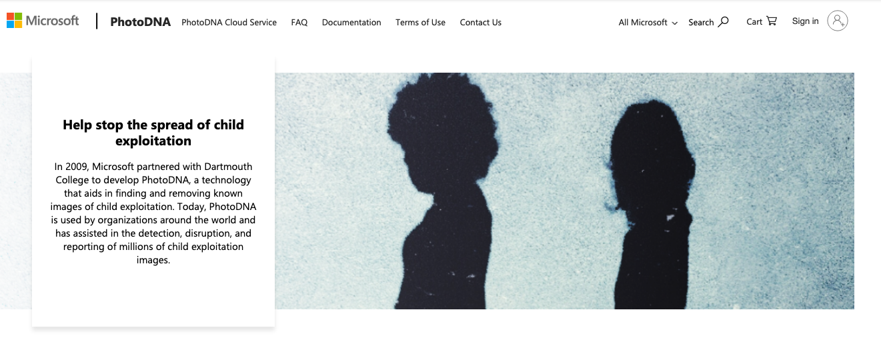
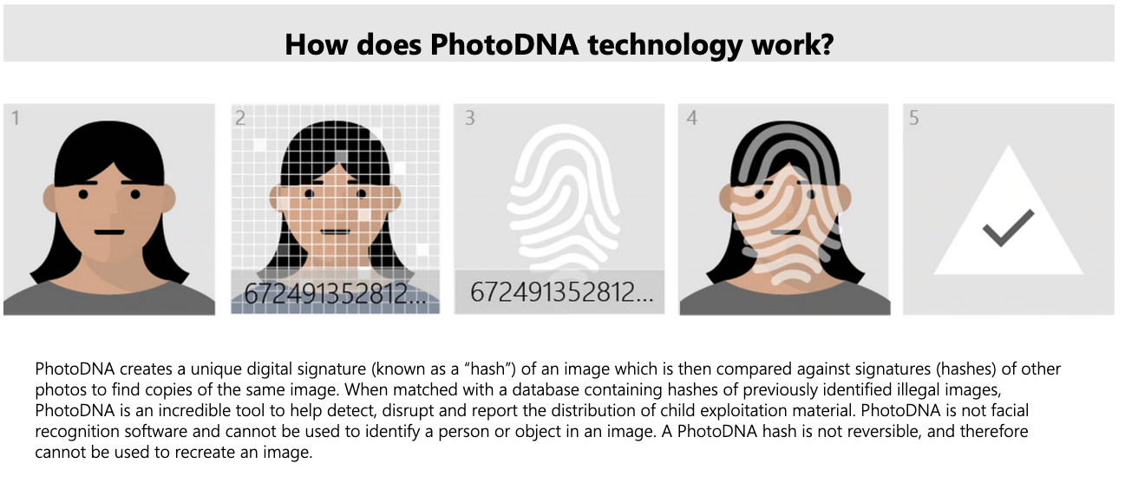
Hash-Based Fingerprinting

Slide 16

Spectral Fingerprinting
Torrent named “Lean On Me”
Downloaded
File
Bill Withers’ “Lean On Me”
Reference
File
Notes:
BEFORE THE NEXT SLIDE

Slide 17
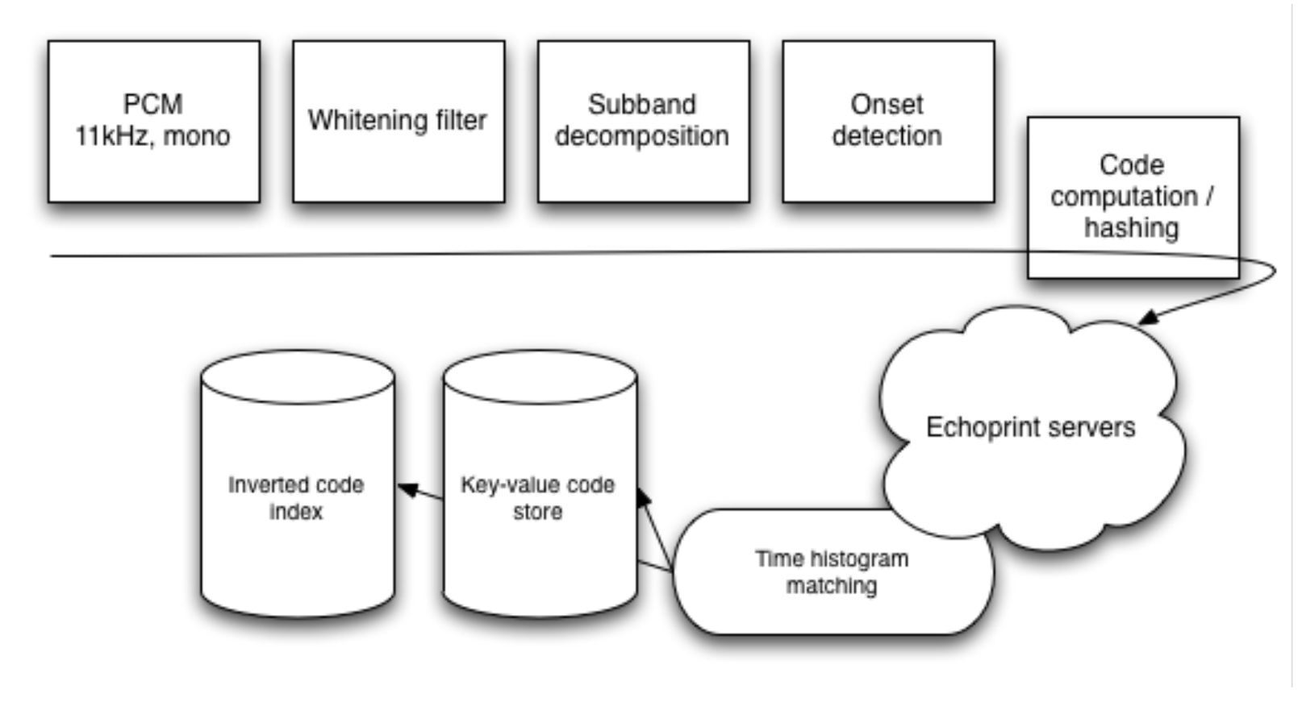
How Echoprint Works
http://mediatechnology.leiden.edu/images/uploads/docs/wt2015_echoprint.pdf

Slide 18
Limitations
Certain types of media only
Based on database of fingerprints
Content can be modified
Lacks context
…

Slide 19
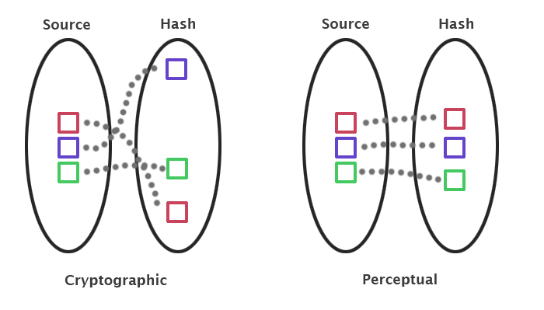
Perceptual Hashing
Notes:
https://bertolami.com/index.php?engine=blog&content=posts&detail=perceptual-hashing

Slide 20


How Perceptual Hashing Works
Convert to greyscale
Downsample (make smaller size)
Convert to frequency space
Capture structural properties
Separate detailed information
Process the transform coefficients

Slide 21
But, Identifying Content is Only Part of the Story…

Slide 22
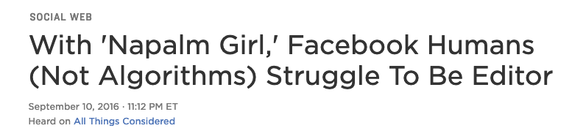

Notes:
That move revealed, in a klutzy way, just how much the company is struggling internally to exercise the most basic editorial judgment, despite claims by senior leadership that the system is working.

Slide 23
Maybe Just Create a Database!

Slide 24
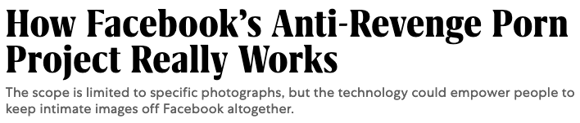

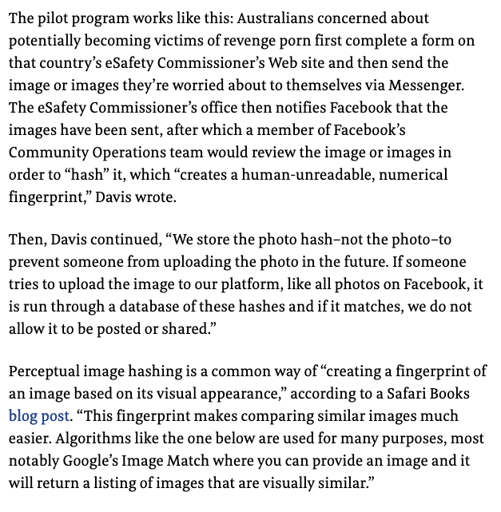
Perceptual Hashing and Databases
User uploads potentially offending photo to Facebook
Facebook computes the perceptual hash
Only the perceptual hash is stored and compared against similar images

Slide 25

The State of Affairs: Political Ads as Issues
Facebook more permissive about political ads concerning parks and parades vs. products
Google did not prohibit any ads whatsoever

Slide 26

Product Ads with Names of Political Candidates

Slide 27
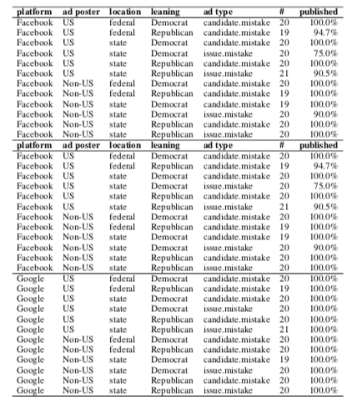
Underblocking/Overblocking are Possible…
Regular blocking of ads for national holidays, national parks, and non-partisan products that share candidate names, …

Slide 28
Content Moderation is Challenging
Offending content is infinite
Context is absent
Fair use?
Parody?
…

Slide 29
AI and Platform Moderation: Looking Ahead
Technology: What are capabilities, limitations?
Understanding/mitigating bad inputs to personalization
Understanding/pushing the limits of automated filtering
Observing and auditing the platforms
Policy: What can/should be required?
Of content providers?
Of platforms and intermediaries?

Slide 30
Discussion
What are the pros and cons of automated filtering?
How could you envision technology companies using this as part of a more holistic approach?
Should they be required to use them in any way?
For what content? Do we stop at hate speech? Sex trafficking? Copyright? …
Who should shoulder the burden of detection?

